Slide 1
Financial Management System Using MongoDB
Done By:-
Vishvam Ganesh(231801189)
AK Tamilselvan(231801177)
Soorya(231801169)

Slide 2
Problem Statement:
Managing personal or organizational finances efficiently is crucial for making informed decisions. Current methods, such as manual bookkeeping or basic spreadsheets, are often prone to errors, time-consuming, and offer limited analysis. There's a need for an automated, user-friendly financial management system that provides real-time insights, transaction tracking, budgeting, and financial forecasting to streamline financial processes.

Slide 3
Objective:
To develop a financial management system that simplifies financial tracking, budgeting, and reporting for individuals or organizations, offering a comprehensive and error-free solution for managing income, expenses, and financial goals.

Slide 4
Abstract:
The Financial Management System is designed to provide a comprehensive solution for personal or organizational financial management. This system help to efficiently handle financial management issue. The process of recording transactions, generating reports, and offering insights into spending patterns and financial health. It integrates features like budget tracking, income and expense categorization, and financial forecasting. The system will ensure accuracy, efficiency, and accessibility to help users make informed financial decisions while reducing the time spent on manual data entry.

Slide 5
Existing System:
Existing financial management systems or traditional methods rely on manual data entry, spreadsheets, or software with limited features. These systems lack automated tracking, often fail to provide real-time insights, and can be error-prone, making it difficult for users to stay on top of their finances and meet their financial goals.
disadvantages of existing system Limited Features: Traditional systems often lack advanced financial tools like predictive analytics or integrated budgeting
Poor Data Security: Storing sensitive financial information in basic systems can make them vulnerable to security breaches.
Inefficient Reporting: Generating detailed financial reports is often cumbersome and lacks customization.

Slide 6
Proposed System:
The proposed Financial Management System will provide a user-friendly platform for manually entering and tracking financial transactions, while offering enhanced features to improve financial planning and decision-making. Users will manually input their income, expenses, and other financial data, but the system will offer tools such as customizable budget creation, financial reporting, expense categorization, and visual analytics like graphs and charts. Unlike existing manual methods, the system will provide an intuitive interface and advanced features like financial goal setting, comparison of actual spending against budget, and easy report generation to give users a clear overview of their financial health.

Slide 7
advantages of proposed system
Visual Analytics: Includes graphs and charts for a clear, visual overview of financial data.
User-Friendly Interface: Provides an intuitive platform for easy financial data entry and tracking.
Enhanced Financial Reporting: Offers comprehensive reports, simplifying financial planning and decision-making.

Slide 8
SYSTEM ARCHITECTURE
2.1 System Architecture
The Financial Management System is designed using a three-tier architecture that ensures efficient processing, organized data management, and enhanced security. This architecture consists of three main layers:
Front-End Interface: The front-end is the user-facing component, providing an interactive web-based interface through which users can perform essential actions like adding, updating, and viewing financial records. This layer is designed with simplicity in mind, prioritizing user experience and ease of navigation. Utilizing responsive design principles, the front-end adapts to various devices, allowing users to access their financial data on desktops, tablets, and mobile phones.
Middle Layer (Data Processing): The middle layer serves as the system’s logic core, where all data processing occurs. It bridges the front end with the backend by handling data validation, processing requests, and managing business logic. This layer ensures that user actions on the front-end, such as categorizing expenses or generating reports, are executed smoothly and efficiently. By employing RESTful APIs, this layer allows for scalable data processing and potential integration with external applications in the future, such as budget calculators or external financial data sources.
Backend Database: The backend is the storage layer where all user data is securely maintained. It employs a relational database management system (RDBMS) to store, retrieve, and manage data efficiently. The backend database is structured to store various categories of user data, including income, expense records, and report histories. Security protocols, such as encryption and user authentication, are implemented to ensure data integrity and prevent unauthorized access.

Slide 9
REQUIREMENTS AND ANALYSIS
4.1 Functional Requirements
The system should allow users to add, view, and delete expenses.
It must generate reports by category, date, and amount.
4.2 Non-Functional Requirements
The application should be responsive and load quickly.
Data security is essential to protect user financial records.
4.3 Hardware and Software Requirements
Hardware: Standard PC or server with internet access.
Software: Web browser, Python, Flask, SQL database.
4.4 Use Case Diagram
Illustrates the interactions between users and the main system functionalities, such as adding expenses, generating reports, and viewing summaries.

Slide 10
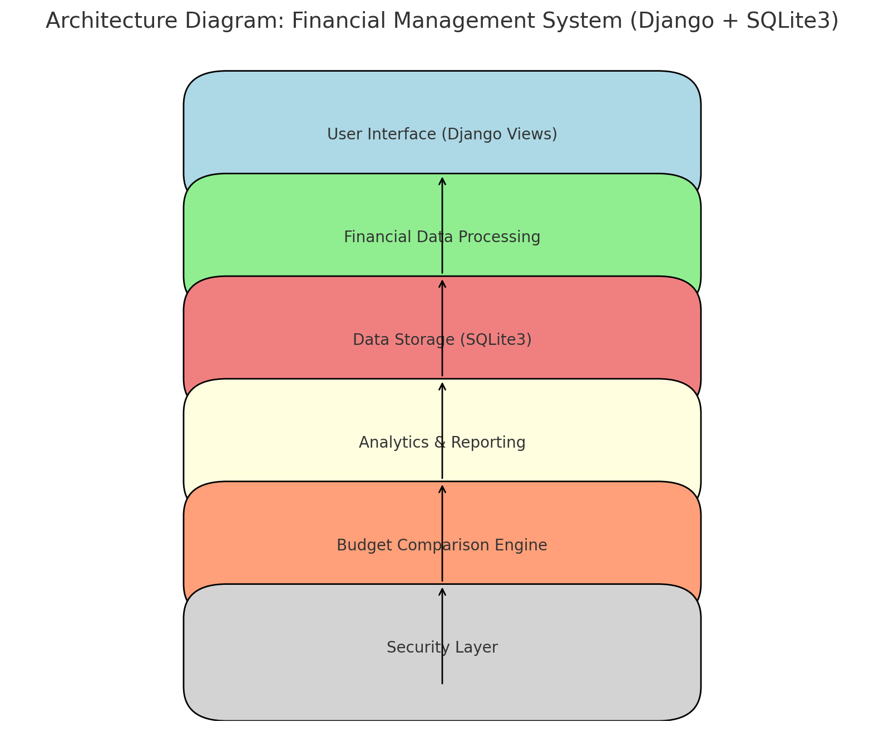
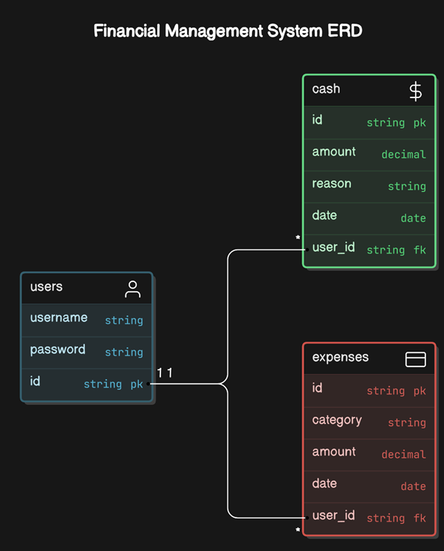
architecture diagram

Slide 11
modules with description
1. User Interface (Django Views)
Description: This module provides the front-end interface where users can manually input financial data, such as income, expenses, and budgets. It also allows users to view visual reports, track their financial goals, and analyze spending patterns. Django views handle requests and responses, rendering templates that present data to the user.
2. Financial Data Processing
Description: This module processes the data input by users. It categorizes transactions, calculates budget adherence, and manages financial goals. It also processes the logic for budget comparison and integrates various data operations, such as expense tracking and income management.

Slide 12
modules with description
3. Data Storage (SQLite3)
Description: This module is responsible for storing financial data in an SQLite3 database. It holds records of all transactions, budgets, and user-specific financial information. The Django ORM (Object Relational Mapper) interacts with this database to store and retrieve data as needed by other modules.
4. Analytics & Reporting
Description: This module generates visual reports, charts, and graphs to provide insights into users' financial activities. It analyzes user data to help them track their expenses, compare actual spending against budgets, and monitor their overall financial health. This module provides real-time analytics for better decision-making.

Slide 13
modules with description
5. Budget Comparison Engine
Description: This module compares actual expenses against the predefined budget set by users. It tracks whether users are adhering to their budget or exceeding it and offers alerts or suggestions to adjust spending. The engine is central to ensuring users can monitor and adjust their financial goals effectively.
6. Security Layer
Description: This module ensures that the system's sensitive financial data remains secure. It manages data encryption, user authentication, and access control to protect users' financial information. This layer applies Django’s built-in security features to prevent unauthorized access or data breaches.

Slide 14
SYSTEM DESIGN
5.1 Database Design and Tables
The database includes tables such as Users, Expenses, and Categories. Each table is designed to hold specific financial data, optimized for retrieval efficiency.
5.2 UI Design Overview
The UI follows a minimalist design, ensuring ease of navigation with a clear layout. The navigation bar provides direct links to different functionalities, such as Dashboard, Add Cash, and Track Expenses.
5.3 Workflow and Process Diagrams
The process flow covers the user journey, from logging in to adding expenses, tracking them, and viewing reports.

Slide 15
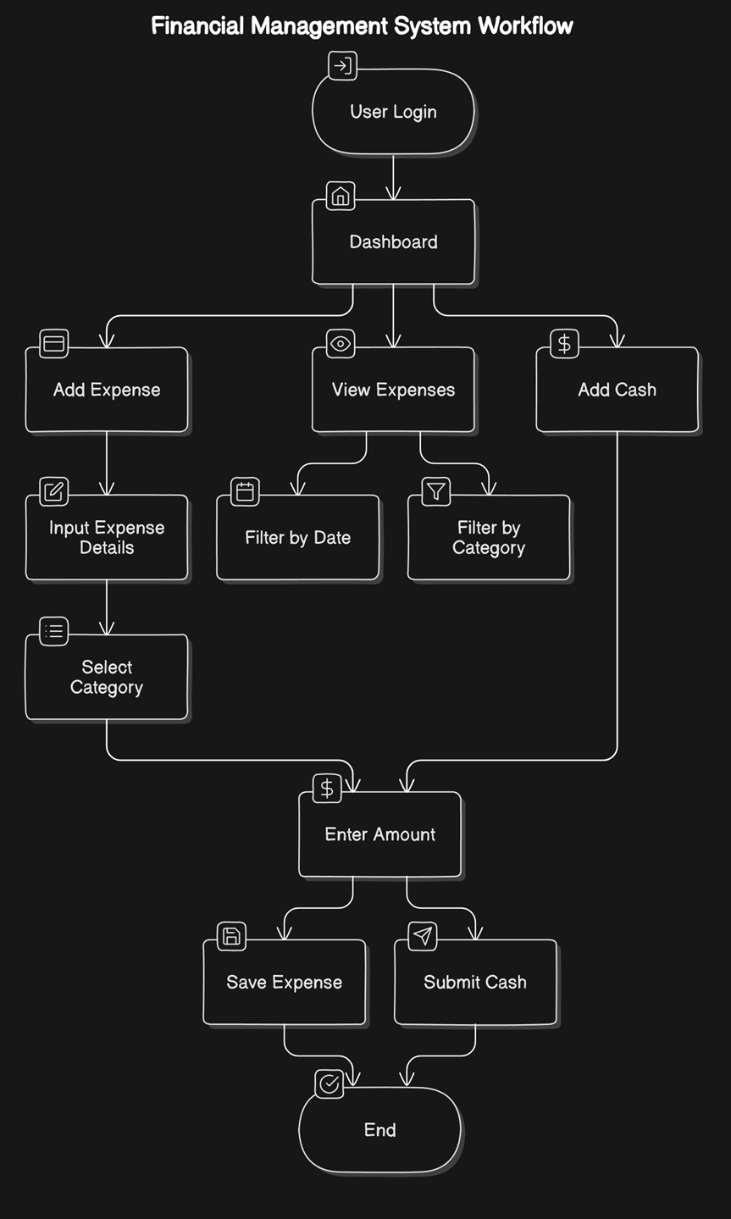
WORKFLOW DIAGRAM

Slide 16
SURVEY OF TECHNOLOGIES
3.1 Software and Tools Used
The development of the Financial Management System utilizes a suite of programming languages, tools, and frameworks designed to facilitate efficient data processing, user interface development, and database management. The core components include:
Python: The primary language for backend processing, responsible for handling business logic, data processing, and communication with the database.
SQL: Utilized for managing structured data storage, ensuring efficient data retrieval and manipulation for the system.
HTML/CSS/JavaScript: Employed in creating the front-end user interface, these languages provide a responsive, interactive, and user-friendly experience.
The system is built on the Flask web framework, which seamlessly links the front-end interface with backend operations, allowing for a smooth user experience and efficient data handling.
3.2 Programming Languages
The Financial Management System leverages multiple programming languages, each fulfilling a specific role within the application:
SQL: SQL is employed for structuring and managing the database. This language allows for complex data querying and efficient data storage, making it ideal for handling the various financial records stored within the system. SQL enables users to retrieve, update, and manage records accurately and efficiently.
Python: Python powers the backend logic and data handling operations. Known for its readability and flexibility, Python is an optimal choice for handling calculations, data validation, and data processing tasks. It manages all backend functionalities, including data insertion, updating, and the generation of financial reports.
HTML/CSS/JavaScript: The combination of HTML, CSS, and JavaScript forms the backbone of the system’s front-end design. HTML provides the structure, CSS enhances the visual layout, and JavaScript introduces interactivity, allowing users to engage with features such as form submissions, record editing, and dynamic report generation. Together, these languages create a responsive and engaging interface that accommodates a range of devices and screen sizes.

Slide 17
FRAMEWORKS AND LIBRARIES
3.3 Frameworks and Libraries
To streamline development and enhance functionality, the system incorporates several frameworks and libraries, including:
Flask: Flask is a lightweight, yet powerful web framework that serves as the primary platform for this application. Flask facilitates the connection between the front-end and backend, enabling seamless communication between the user interface and the data processing logic. Flask’s modular nature makes it a suitable choice for building scalable applications with minimal overhead.
SQLAlchemy: SQLAlchemy is an Object-Relational Mapping (ORM) library in Python, used to handle database operations within the system. By abstracting the SQL commands into Python code, SQLAlchemy simplifies the interaction with the database, enabling efficient data querying and manipulation. This ORM tool also enhances security by mitigating risks associated with raw SQL queries, such as SQL injection. Additionally, SQLAlchemy improves data handling efficiency, making it easier to maintain complex database interactions while keeping code readable and maintainable.
These frameworks and libraries contribute to a cohesive and functional system, offering a solid foundation for future expansion and improvements. Each component plays a vital role in creating an efficient, user-friendly Financial Management System, balancing ease of use with powerful data handling capabilities.

Slide 18
IMPLEMENTATION
Code Structure and Organization
The Financial Management System is organized into a modular code structure to improve readability, maintainability, and scalability. Each component of the project is divided into specific files and folders, each responsible for distinct functionalities, enabling a clear separation of concerns. This modular approach also facilitates debugging and future expansion, as new features can be added or modified without affecting unrelated parts of the codebase.
The codebase is organized as follows:
Application Folder: Contains the main Flask application file, which manages the routes and data flow between the front-end interface and the backend.
Modules Folder: Each core function of the system (such as expense tracking and reporting) is separated into its own module file, allowing the program to handle these functionalities independently.
Templates Folder: This folder contains HTML templates used for the web interface. Flask's templating engine is used to dynamically render these templates with data from the backend, ensuring an interactive user experience.
Static Folder: Stores CSS, JavaScript, and image files used for styling and front-end functionality.
Database Configuration: Contains files for managing database connections and configurations, including initialization scripts for the database schema.
The main Flask file is responsible for routing, serving as the entry point of the application. Each route corresponds to a particular functionality, such as adding an expense or generating a report, making the codebase modular and easy to navigate.

Slide 19
TESTING AND VALIDATION
7.1 Testing Strategies
The Financial Management System underwent a rigorous testing process to ensure functionality, accuracy, and performance. A combination of unit testing, integration testing, and user acceptance testing was employed to verify each component and the system as a whole:
Unit Testing: Individual modules were tested in isolation to verify that each function performed correctly. Unit tests focused on core functionalities, including expense addition, data validation, and report generation. This approach ensured that each module was robust and handled a variety of input scenarios effectively.
Integration Testing: Once individual modules passed unit testing, integration tests were performed to check the interactions between modules. The goal was to confirm that data flows smoothly across the system, from user input on the front-end interface to backend processing and database storage. Integration testing also ensured that the web interface displayed data accurately and responded correctly to user actions, such as adding or updating expense records.
User Acceptance Testing (UAT): After unit and integration testing, user acceptance testing was conducted to validate the system from an end-user perspective. Testers followed typical user scenarios, such as entering expenses, generating reports, and checking for data consistency. This final stage of testing helped ensure that the Financial Management System met user needs and expectations.

Slide 20
7.2 Test Cases and Results
A set of comprehensive test cases was created to assess the accuracy and reliability of the Financial Management System. The primary test cases and their results are outlined below:
Input Validation: Tests were conducted to verify that the system correctly validated user inputs, such as expense amounts, dates, and categories. Invalid entries (e.g., negative amounts or missing fields) were rejected with appropriate error messages. All input validation tests passed successfully.
Expense Calculations: The system was tested for accurate calculation of expense totals by category and time period. Various scenarios, including high-volume entries and simultaneous updates, were tested to ensure consistent results. All calculations were verified as correct.
Data Retrieval and Reporting: Tests assessed the system’s ability to retrieve and display expense data accurately in reports. Queries based on date ranges, specific categories, and other criteria were performed to verify data accuracy. The reporting functionality was confirmed to display data correctly with accurate summaries and charts.
Database Operations: Tests were conducted to verify the reliability of data storage, retrieval, updating, and deletion in the database. Tests confirmed that all database transactions were processed accurately, with no data loss or duplication.
All critical test cases passed, confirming that the system performs reliably under expected usage conditions.
7.3 Bug Fixes and Improvements
During the testing process, several bugs were identified and resolved to enhance the stability and usability of the Financial Management System. Key issues included:
Data Synchronization Issues: In some cases, data entered by users was not immediately reflected in the reports due to delays in database updates. This issue was resolved by implementing real-time data synchronization and optimizing database calls. Caching was also introduced to improve response time for frequently accessed data.
Category Misclassification: Some expenses were occasionally misclassified due to inconsistencies in the data validation logic. To address this, stricter validation checks were added in the backend code, ensuring that each expense is accurately assigned to the correct category.
Error Handling Enhancements: Initial testing revealed some unhandled exceptions during user input validation and database connection failures. To improve robustness, comprehensive error handling mechanisms were added to catch and manage these exceptions gracefully, preventing disruptions to the user experience.

Slide 21
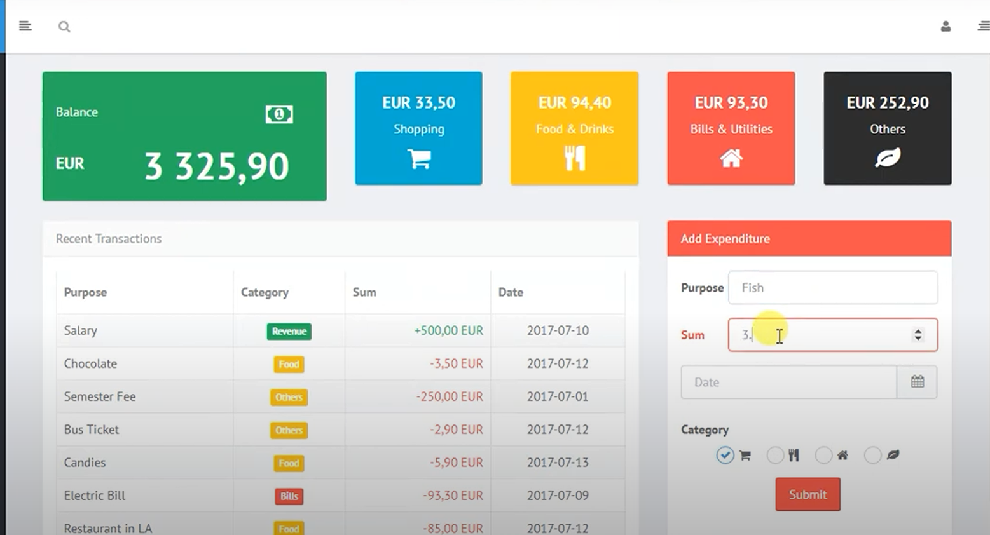
sample outputs

Slide 22
RESULT AND DISCUSSION
8.1 Summary of Features
The Financial Management System successfully delivers a comprehensive set of features for personal finance management. The system enables users to:
Track Expenses: Users can add expenses across multiple categories, providing a clear view of their spending habits.
Generate Reports: Customizable reports allow users to analyze their financial data by category, time period, or custom criteria. Visual aids, such as charts and graphs, make it easier for users to understand their financial trends.
Data Management: The application ensures secure storage of all financial data, with efficient options to update, delete, or modify expense entries as needed.
User-Friendly Interface: Designed with usability in mind, the interface provides an easy-to-navigate experience, accessible to users of all technical levels.
These features make the system a versatile tool for users seeking a structured approach to managing personal finances.

Slide 23
8.2 User Experience Feedback
Feedback from initial users indicates high satisfaction with the system’s functionality and design. Users reported that the application’s interface was intuitive, allowing them to quickly learn how to add expenses and generate reports. Key areas of positive feedback included:
Simplicity: Users appreciated the straightforward design and clean layout, which made it easy to navigate and utilize essential features without unnecessary complexity.
Responsiveness: The web-based interface performed well across different devices, adapting smoothly to various screen sizes. This flexibility allowed users to access the system on desktop computers, tablets, and smartphones, enhancing accessibility.
Functionality: The application’s features for categorizing expenses and generating reports were highlighted as particularly useful for tracking and understanding spending patterns.
Overall, user feedback suggests that the Financial Management System effectively addresses user needs for daily financial tracking.
8.3 Potential Improvements
While the current system performs well, several enhancements could increase its functionality and user value:
Banking API Integration: Incorporating banking API support could allow users to import transactions automatically from their bank accounts, reducing the need for manual data entry and providing a more seamless experience.
Enhanced Data Visualization: Future versions could introduce advanced data visualization options, such as customizable graphs, spending trends over time, and interactive charts. This would provide users with deeper insights into their financial habits and enable more detailed financial analysis.
Budgeting Features: Adding budgeting tools that allow users to set spending limits by category could further support financial planning and help users achieve savings goals.
Mobile Application: Developing a standalone mobile app version would enhance accessibility and convenience for users who prefer tracking finances on their mobile devices.

Slide 24
CONCLUSION AND FUTURE WORK
The Financial Management System project provides a robust solution for managing personal finances, integrating a range of features that streamline the process of tracking expenses, managing income, and generating insightful summaries. The system is designed with a focus on usability and practicality, empowering users to maintain an organized record of their financial transactions and make informed decisions. By allowing users to categorize expenses, add cash entries, and view an up-to-date financial summary, the system promotes financial awareness and accountability.
One of the project’s most notable achievements is its ability to simplify complex financial tracking tasks into an accessible and user-friendly platform. The system’s main interface, the Dashboard, presents a clear, at-a-glance summary of financial health, enabling users to view spending patterns and income flow effortlessly. With intuitive features like Add Expense and Add Cash, users can keep a precise record of all transactions, ensuring their data is comprehensive and current.
The technical foundation of the system is built on reliable back-end frameworks, including Flask for web application management and SQL Alchemy for secure and efficient database operations. The front-end, designed with Bootstrap, combines responsive design and functionality, ensuring a smooth user experience across different devices. These elements contribute to the system’s high performance and ease of use, emphasizing data accuracy, accessibility, and secure storage.
Additionally, the project’s modular and scalable code structure allows for potential future enhancements, making the system adaptable to evolving user requirements. As a foundational tool, this Financial Management System sets the stage for more advanced financial features that could be added in future versions. Examples of these enhancements include real-time analytics, advanced data visualization, and budgeting tools based on historical data. The modularity also supports the integration of predictive financial planning, enabling users to forecast future expenses and manage their finances proactively.
In summary, this Financial Management System not only meets its primary objectives but also lays the groundwork for an evolving, feature-rich tool tailored to personal finance management. The system serves as a practical and essential resource for individuals looking to manage their finances more effectively, and with additional development, it has the potential to become an invaluable asset. By incorporating features such as automated categorization using machine learning, API integration with banks for real-time data updates, and personalized budget recommendations, future versions of the system could adapt to the dynamic needs of users in today’s digital economy.

Slide 25
REFRENCES
Python Documentation, https://docs.python.org/
Flask Documentation, https://flask.palletsprojects.com/
SQLAlchemy Documentation, https://docs.sqlalchemy.org/
Bootstrap Documentation, https://getbootstrap.com/

